Slide 1

Hotel Revenue Analysis

Slide 2
Agenda
Problem Statement
Data overview & Methodology
Analysis & Findings
Recommendations
Questions

Slide 3
Problem Statement
AtliQ Grands owns multiple five-star hotels across India. They have been in the hospitality industry for the past 20 years.
They are losing their market share and revenue due to strategic moves from other competitors and ineffective decision-making in management.
So they need us to provide insights from their historical data.

Slide 4
Data overview & Methodology
Provided us data containing, hotel name, category, city, booking id, check in dates, room category etc.
Power Bi – Data cleaning, analysis & visualization

Slide 5
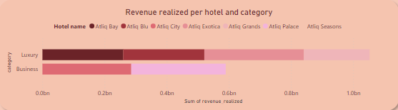
Analysis & Findings
Total of 2 billion revenue from all hotels.
Highest being Atliq exotica in luxury category and Atliq city in Business category.

Slide 6
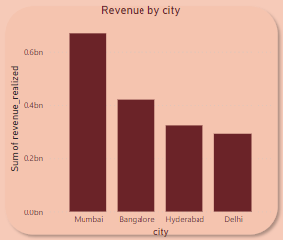
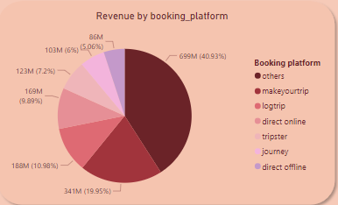
More revenue is generated from Mumbai.
Other booking methods are playing crucial role in generating more revenue.

Slide 7
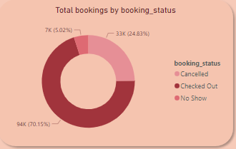
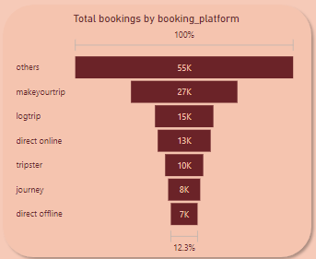
75% of bookings are occupied, 20% are cancelled and 5% are no show.
Majority of the bookings are through other booking methods.

Slide 8
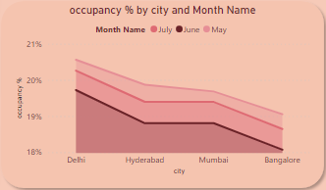
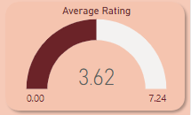
Occupancy is more in the month of May and in city Delhi.
Average rating provided by customers is 3.62.

Slide 9
Recommendations
Other sources used for booking should be found out and stream lined since major part of revenue depends on it.
Even though the occupancy rate is higher is Delhi the revenue generation is low. Management techniques should be focused there.

Slide 10

Questions

